Slide 1



Integrated Program in Business Analytics
Health Care - Ventilator Pressure Prediction
IPBA Batch 10 – Group – I
Participants:-
Ms Priyanka Gedam
Mr Rajesh Mane
Mr Sameer Kumar Jha
Ms Devyani Raut
Mr Kumar Kundan
Ms Kushboo Lalwani
Ms Mansi Patil
Mr Denis

Slide 2
Agenda
Business Problem and Objectives
Domain Understanding & Key Business Assumptions
Data Understanding and Preparation Part I
Data Preparation and Pre-processing Part II
Exploratory Data Analysis
  Key Business Findings and Insights
Model Development and Validations
Model Accuracy Cross Check & Finalization
Businesss Recommendations and Potential Business Impact

Slide 3



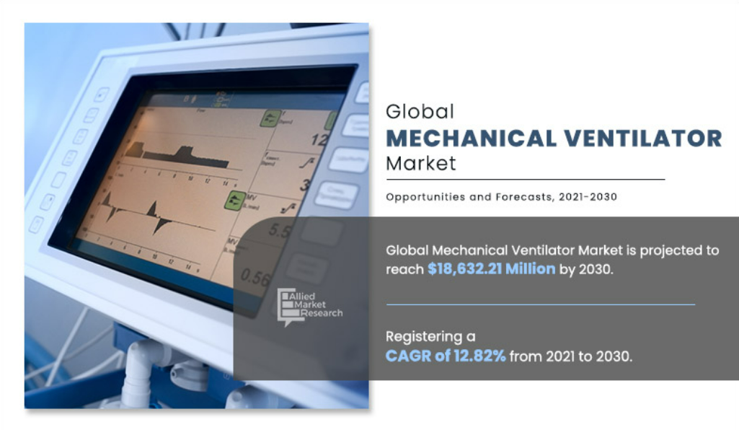
Business Perspetive.....
The burden of respiratory diseases is rising globally. So as increasing demand for critical care equipment due to the growing number of ICU admissions.
Every Hospital ICU is the most expensive area where ICU staff provided round the clock in a hospital. ICU beds account for at least 10% of the hospital beds and 20-40% of all hospital costs, only for Mechanical Ventilator
Average daily cost for ventilated patient is US$270 in that major component of Fixed cost of clinician intensive support staff. (Source : https://www.ncbi.nlm.nih.gov/)
Due to high cost of clinician intensive associated with MV, hospitals are facing thru emerging challenges of cost reduction and offer affordable treatment to the patient.

Slide 4
Business Objectives
Cost Reduction
Adopt Advance technological
Minimize Manual Intervention and risk of failure
Assigned Data Scientist Team

Slide 5

Understanding
Respiratory Diseases
Provide critical support for patients who have difficulty in breathing
Invasive Ventilation Process
Ventilator consists of a compressed air source, valves to control the flow of air into and out of the lungs, and a "respiratory circuit"
Clinician-Prescribed
These ventilators require significant attention from highly-trained clinicians in order to ensure that their performance matches the patients’ needs and that they do not cause lung damage
The ventilator follows a clinician-prescribed breathing waveform based on a respiratory measurement from the patient (e.g., airway pressure, tidal volume).
PID Controller
Proportion(“P”) — a comparison of the measured and target pressure;
High Skilled Clinician
Integral (“I”) — the sum of previous measurements
Differential (“D”) — the difference between two previous measurements.
Machine-Learned Ventilator Controller
Algorithm that measures airway pressure
Model-Based Approach

Slide 6
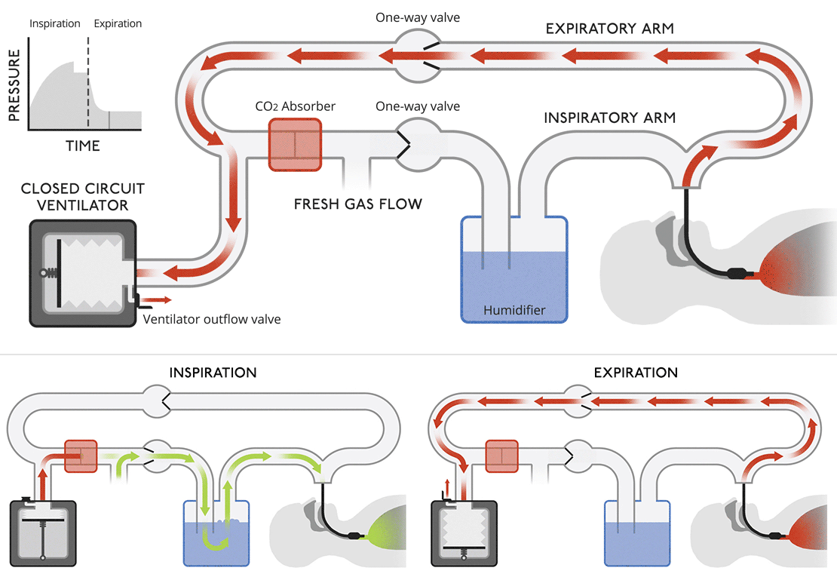
Data Understanding & Preparation
Id :- globally-unique time step identifier across an entire file
Breath_ID:- globally-unique time step for breaths
R_lungs:- lung attribute indicating how restricted the airway is (in cmH2O/L/S)
C_Lungs:- lung attribute indicating how compliant the lung is (in mL/cmH2O)
Time_steps:- the actual time stamp
U_in:-the control input for the inspiratory solenoid valve
U_out:- the control input for the exploratory solenoid valve.
Pressure:- the airway pressure measured in the respiratory circuit
R & C Lungs Characteristics
Pressure
U_Out
U_in

Slide 7
Need to Discussed with team

Slide 8
Thank You

